Slide 1

ENGR 201 What is a Profession?

Slide 2
PROFESSION & PROFESSIONALISM
Professions – a history
Modern Professions
Professional in society

Slide 3
History of Professions
Religious origin to an idea of profession
“To profess” was to declare one’s faith publicly
In Medieval Europe meaning had broadened to
Member of religious order
Member of secular guilds of blacksmiths, cloth makers, lawyers, carpenters, doctors etc.

Slide 4

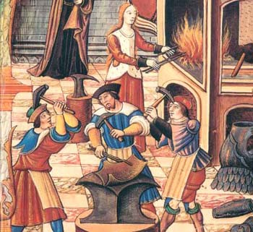
Professions in Medieval Europe
Religious Orders
Secular Guilds

Slide 5
Guilds
Exclusive organizations created to preserve rights and privileges of membership.
Two types –
Merchant guilds – created to protect traders.
Craft guilds – group of craftsmen involved in same profession: bakers, cobblers, carpenters, masons
Association was always given authority from kings, city hall or even clergy.

Slide 6
Functions of a guild
Responsibilities
Restricted poor workmanship
Forbade advertising
Regulated prices
Exerted monopoly control
Limited number of masters
Services
Gave some health insurance to members
Supported dependents of members in case of death
Made donations to city
Served as councilors
Constructed public buildings

Slide 7
Medieval Guilds
http://www.youtube.com/watch?v=vnQlHeee9Dw&feature=related

Slide 8
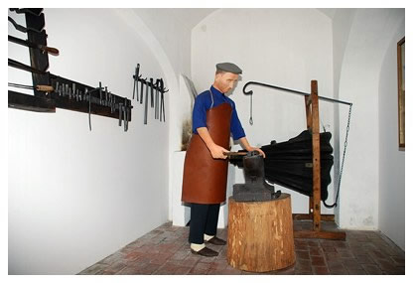
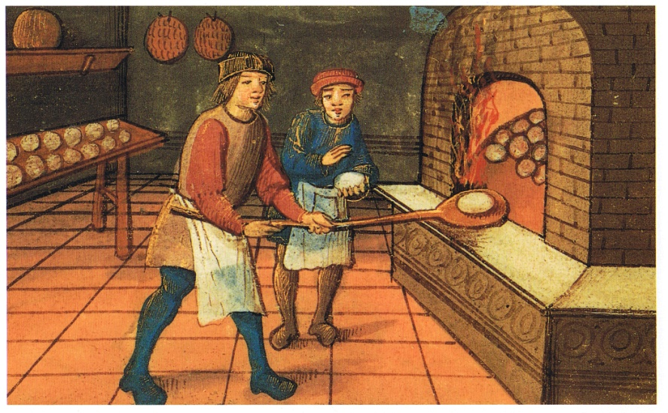
Organization of Guilds
Guilds – associations of craftsmen in a trade.
Craftsmen – owned businesses that produced goods or services.
Journeyman – worker with salary
Apprentices – those who worked for craftsmen

Slide 9
Organization of Medieval Professions
Guild
Craftsmen
Apprentice
Journeyman
Craftsmen
Apprentice
Craftsmen

Slide 10
Modern Professions

Slide 11

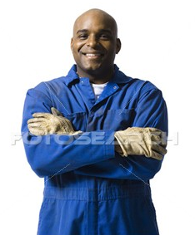
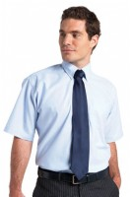
Working in the Modern World
Worker
(Blue Collar Worker)
Professional
(White Collar Worker)
Business Entrepreneur

Slide 12
Work in the Modern World
White Collar (professional) work –
salaried
administrative or technical work
Blue Collar work –
members who sell their manual labour (skilled or non-skilled)
Earn hourly wages for their labour.
Business Entrepreneur –
owns a business enterprise
generates revenue from a stock of human, financial or physical capital.

Slide 13
Modern understanding of professions
A person bearing a special knowledge
Profession is a social category marked by a formalized (or institutionalized) pattern of social relations.
Numerous professional orders – dentists, lawyers, doctors, nurses, engineers, accountants, architects.

Slide 14
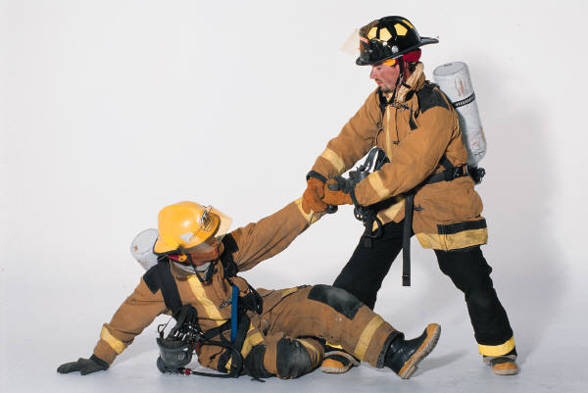
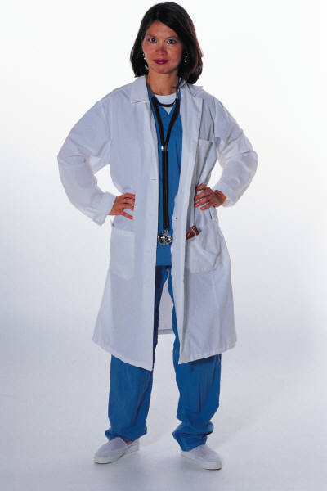
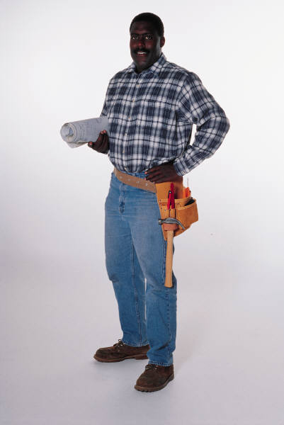
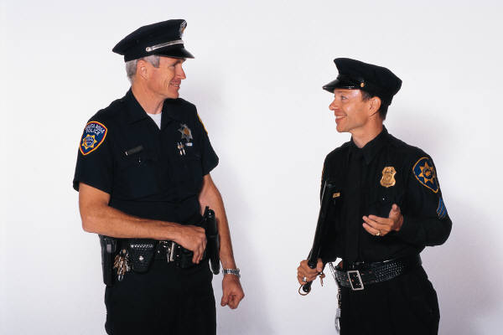
Are they professionals?

Slide 15
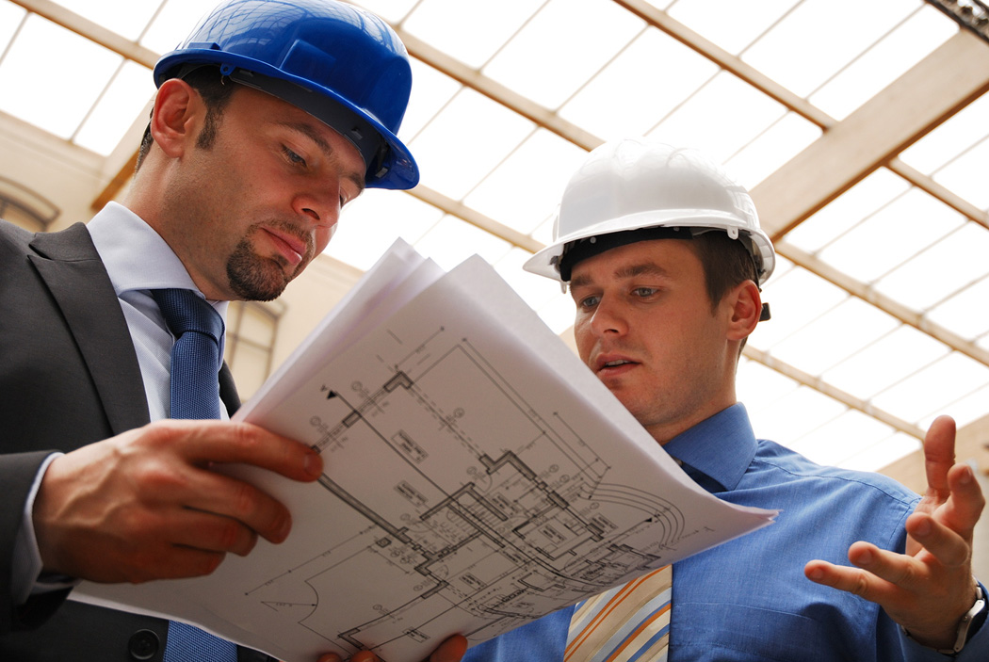
Attributes of a Professional
Skills – formalized education or training
Judgement – requires exercising discretion
Membership in self-governing societies
Contributes to public welfare

Slide 16
Attributes of a Professional
Skill
Judgment
Varied & intellectually demanding skills
Techniques acquired from an extensive formal education
Not limited to practical training or apprenticeship.
Not routine work that can be mechanized
Requires making choices that are based on training.
Need to make decisions autonomously
Choices have consequences on public

Slide 17
Attributes of a Professional
Membership
Public Welfare
Membership of special societies or organizations.
Professional organizations are self-governing.
Members set professional standards.
Enforce codes of conduct & behavior.
Professional practice results in significant public good.
Malpractice can negatively impact lives of public.
Image of profession is related to acting in the public interest

Slide 18
In Canada
Canada Labour Code – a “professional employee”
is, in the course of their employment, engaged in the application of specialized knowledge ordinarily acquired by a course of instruction and study resulting in graduation from a university or similar institution, and
is, or is eligible to be, a member of a professional organization that is authorized by statute to establish the qualifications for membership in the organization.

Slide 19
Two Categories of Professionals
Independent Professionals
Employed Professionals
Paid for service provided
Greater autonomy in professional actions
Ex: Consulting Engineer, Private Doctors, Architect
Paid a regular salary for employment in an organization
Pursue their profession within an organizational setting.
Ex: Nurses, Line Engineer, Architectural Firm

Slide 20
The Professional System
The formalized system that links professions with society.
System ensures that professions are organized to be accountable to public and society.
Professional associations are key aspect of this linkage
Engineers
Professional Associations
Society

Slide 21
Operation of the Professional System
System that governs actions of professionals
Formal rules to guide actions of professionals
Confers licenses to regulate professionals
Breaking rules can result in loss of license to practice
Professional system supervised by the government.

Slide 22
Professions & Society
Why do we need a professional system?
Because “all professions are moral enterprises that involve concerns beyond the applications of technical principles.” (Firmage 1980)

Slide 23
Variations in Professional Systems
“How well professions meet their moral obligations determine the freedom of the enterprise.” (Firmage 1980)
In Europe with a longer history of professionals, there are detailed legal requirements
In USA there are fewer legal requirements of professionals
Canada and Quebec are intermediate

Slide 24
Variations in Professional Systems
Engineers
Prof. System
Society
European Professional System
Engineers
Prof. System
Society
Engineers
Prof. System
Society
Canadian Professional System
American Professional System

Slide 25
Qualities of Professionals
Highly educated
Part of a skilled community of practitioners
But, do they have high incomes ???
Salaried people
Above average incomes for most.
So what is the position of professionals in society?

Slide 26
Position of Professionals in Society
Being a professional gives high social status
Two reasons:
Society greatly values professionals for their skill and for their expertise.
Contribute to public welfare

Slide 27
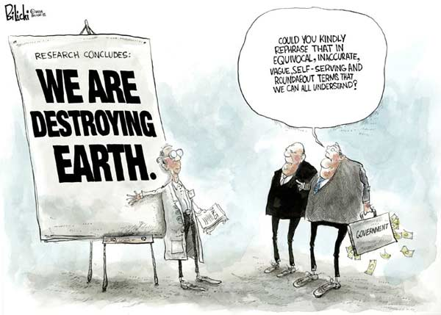
Status of Professionals in Society
As a counter to the messiness of democracy.
Politicians as decision makers do not have technical backgrounds.
Technical experts can provide a scientific basis to solve world problems.

Slide 28
But with Status comes Responsibility
Moral Responsibility
Responsibility to do the ethically correct action
Social Responsibility
Responsibility to bear public safety, health and wellbeing as paramount.
Legal Responsibility
Responsible to act within existing legal boundaries

Slide 29
Resolving Dilemmas
But what happens when our Moral, Social & Legal Responsibilities & Values point in different directions??

Slide 30
What is the Professional System in Quebec
In the Next Class!

